Slide 1
CUSTOMER RETENTION PROJECT

Slide 2
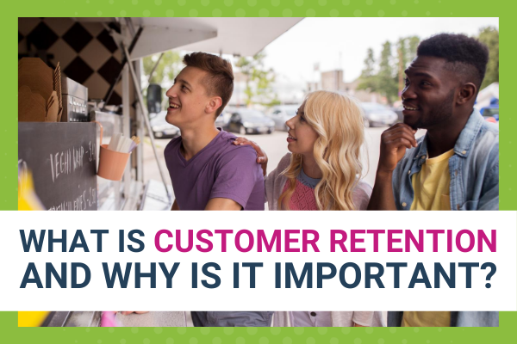
When we talk about any successful business then emphasis should always be on current customers.
Customer Retention is a process to keep cutomers for a long term.
it’s usually measured as the percentage of customers who made a repeat purchase over a specific period of time.

Slide 3
Problem Statement
In current scenerio “Customer Retention” is a very difficult task to all the companies, beacause of there are plenty of options to customers to switch between.
Every customer wants customized offers , more discount , ease of searching products/services, perticular product /service suggestions, product exchange,refunds, excellent customer care services etc.
So now the question is how to make stratagies for more customer retention. On which factors companies should do work for this.

Slide 4
Ways to Track Customer Retention
Repurchasing
Researching
Subscription
Engagement
The easiest way to see customer retention in action is through repeat purchases.
IF customer re-searching the product again and again in same website,it should be an indicator to brand loyalty.
customers might keep their subscription current, and they renew at the end of each period.
when focus is on customer retention, then also pay close attention to ways to engaging customers through marketing, campaigns, and so on.

Slide 5
WHY IS CUSTOMER RETENTION IMPORTANT?
IT ALLOWS YOU TO BUILD LONG-TERM, MEANINGFUL RELATIONSHIPS WITH CUSTOMERS.
IT REDUCES MARKETING COSTS AND BOOSTS YOUR SALES.
IT EMPOWERS CUSTOMERS TO SHARE FEEDBACK WITH YOU AND YOUR TEAM.

Slide 6
Analysys of Data Set

Slide 7
About Data Set (customer_retention_dataset)
Rows | 269
Columns | 71
Data Types | int (46), object (25)
Null Values | No Null Values

Slide 8
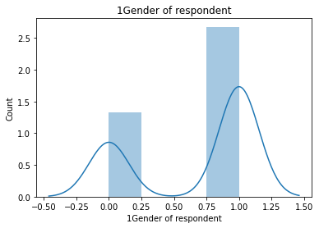
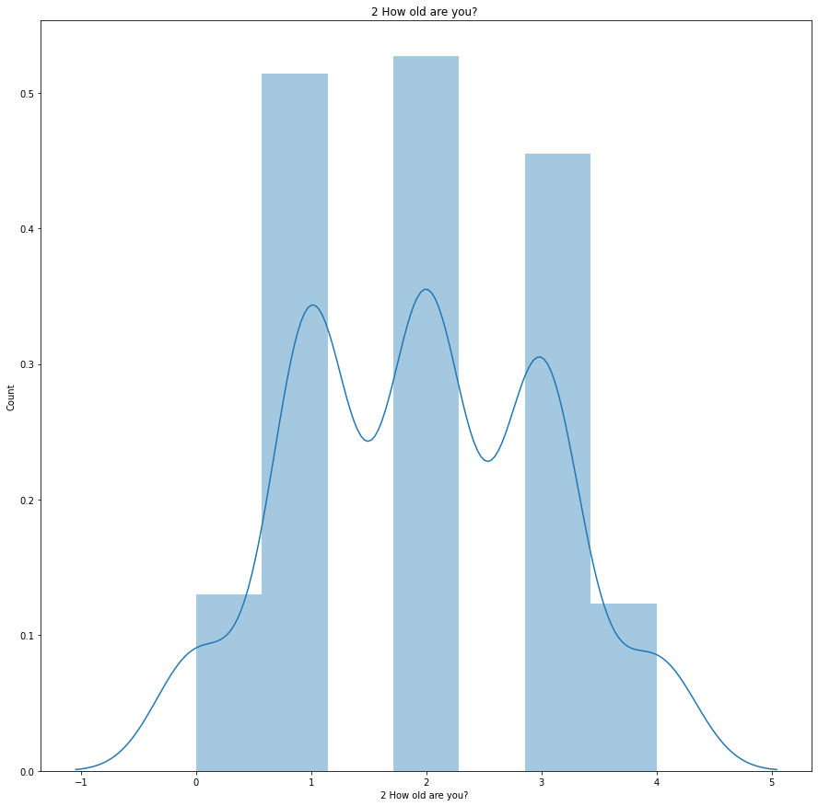
Fig. indicates that Femals are more interested in online shopping then male.
Fig. indicates that the age group 21-30 are more interested then other age group .

Slide 9
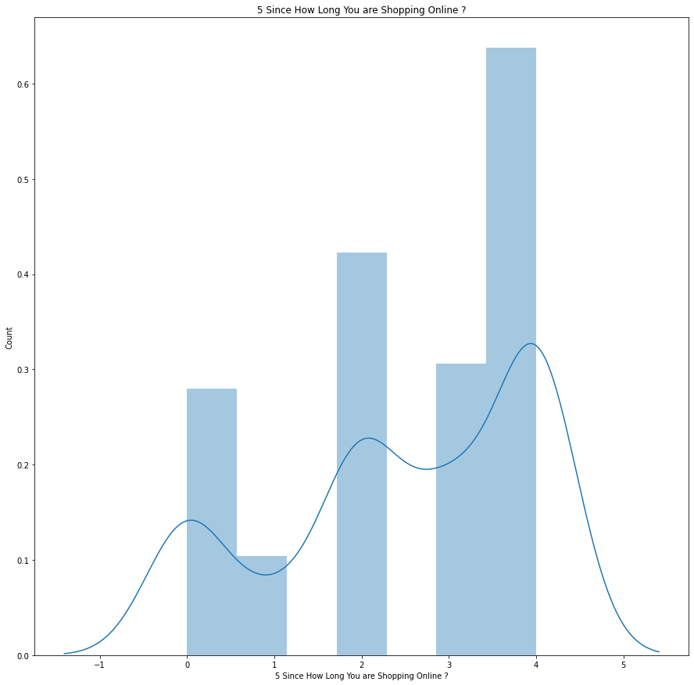
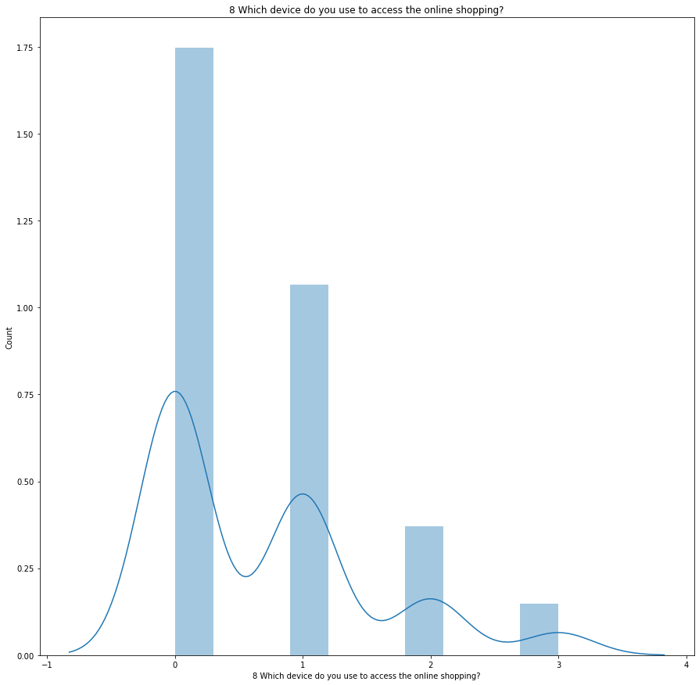
Mostly customers are shopping since last 3-4 years
Customers frequently use mobile devices for online shopping.

Slide 10
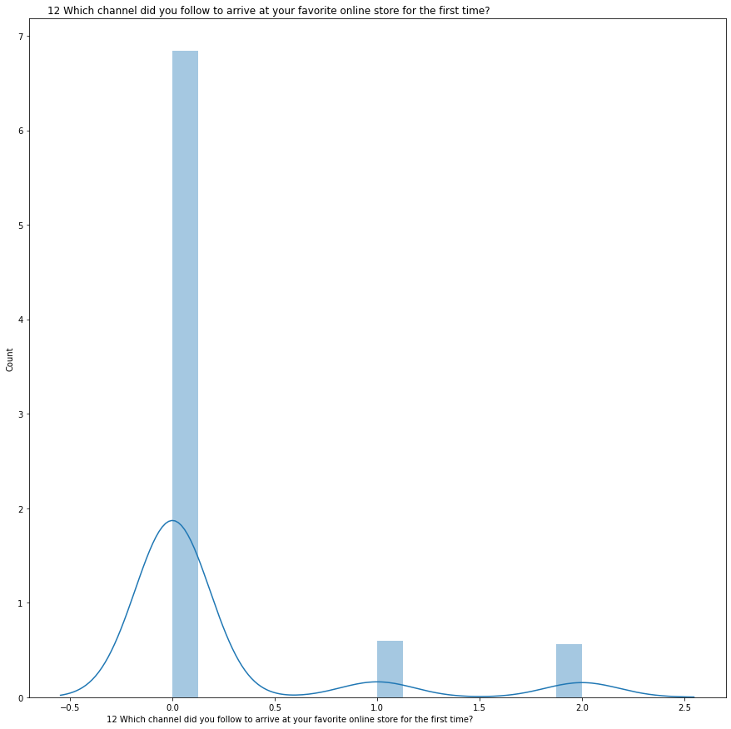
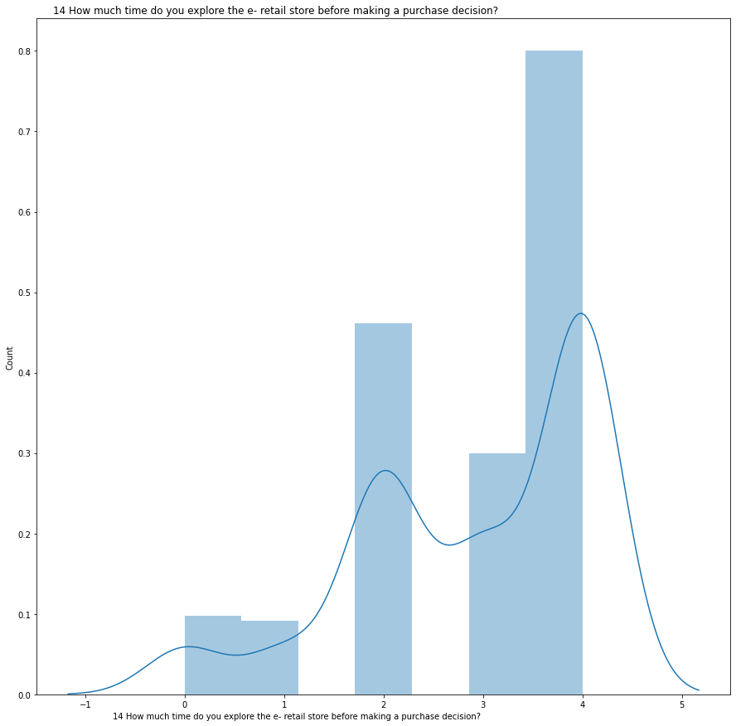
Search engine is frequently used to arrive at favourite online store.
Mostly customer spent more than 15 minute before making a purchase decision.

Slide 11
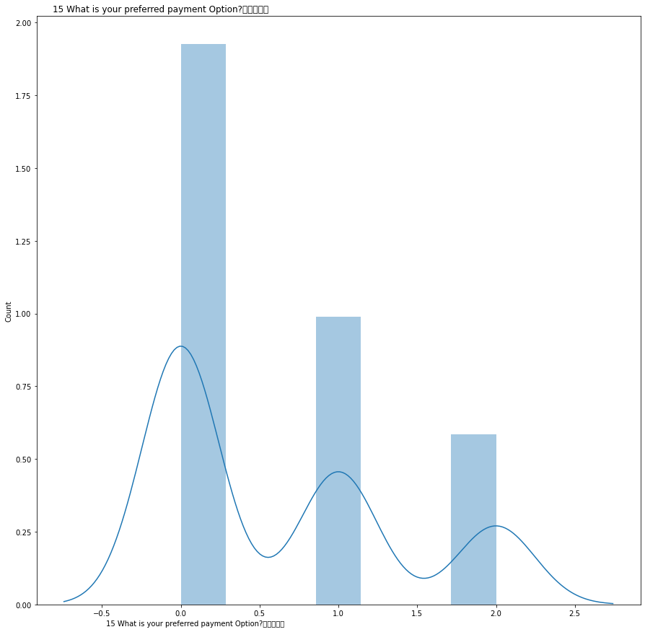
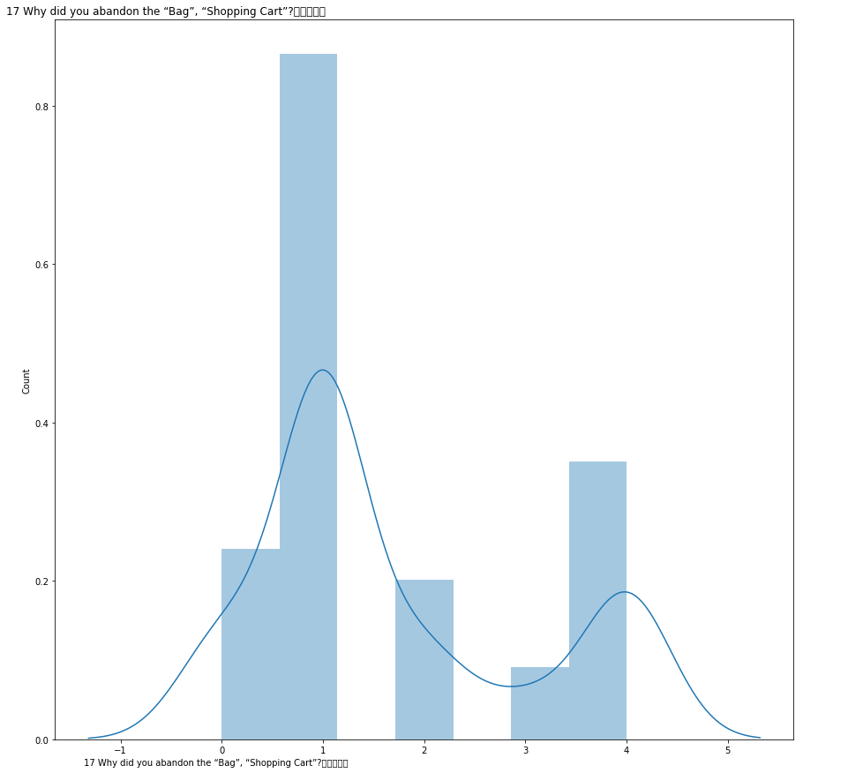
Most customer uses Debit/Credit card for payment.
Customers abandon the cart just beacause of they have better alternative offer.

Slide 12
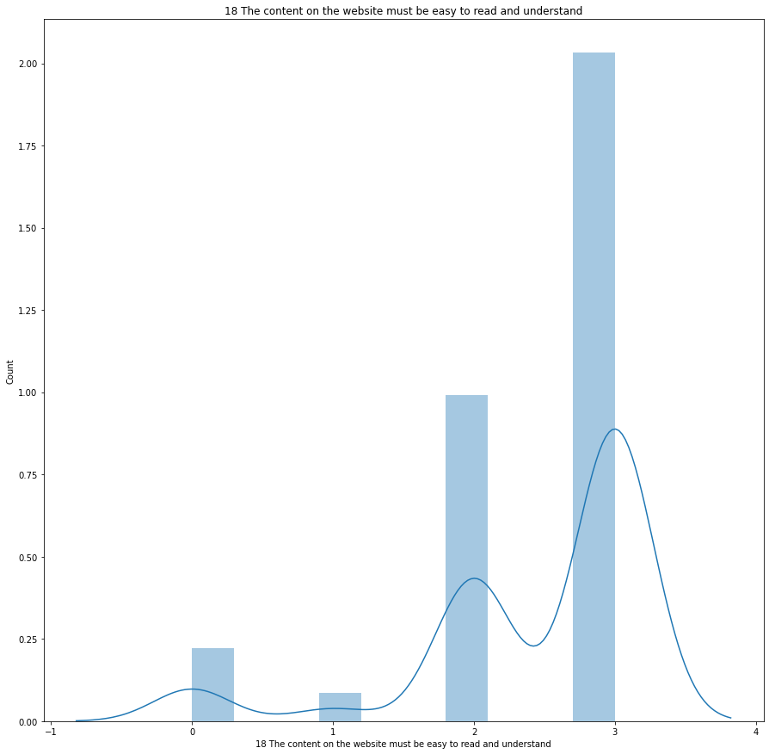
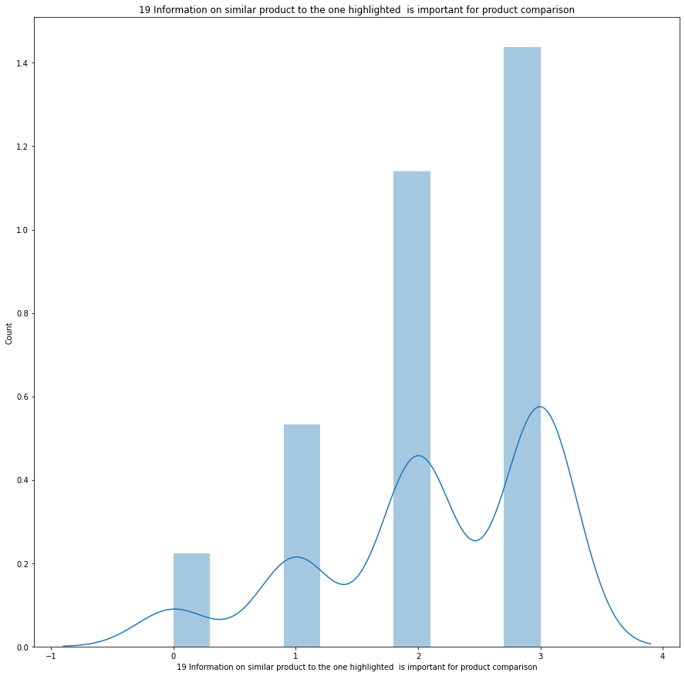
Mostly customers are strongly agree that content of the websie should be easy to read and understand.
Customer wants more comparison of similar type product .

Slide 13
Amazon.in, Flipkart.com, Paytm.com, Myntra.com, Snapdeal.com 82
Amazon.in, Flipkart.com, Myntra.com, Snapdeal.com 44
Amazon.in, Flipkart.com 32
Amazon.in, Flipkart.com, Paytm.com, Snapdeal.com 29
Amazon.in, Flipkart.com, Snapdeal.com 27
Amazon.in, Paytm.com, Myntra.com 20
Amazon.in 16
Amazon.in, Paytm.com 12
Amazon.in, Flipkart.com, Paytm.com 7
Amazon.in, Flipkart.com, Paytm.com, Myntra.com, Snapdeal.com are frequently used website for shopping in India.

Slide 14
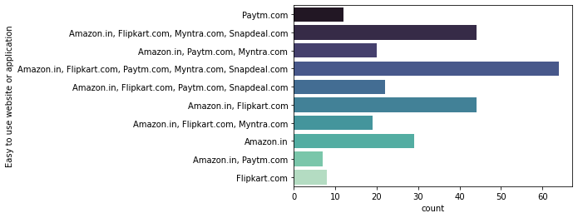
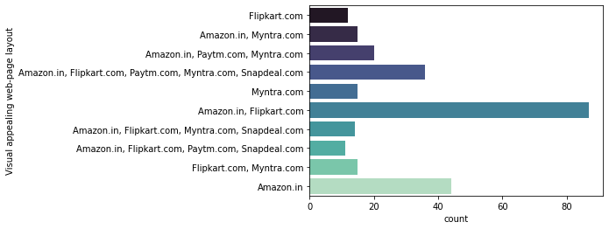
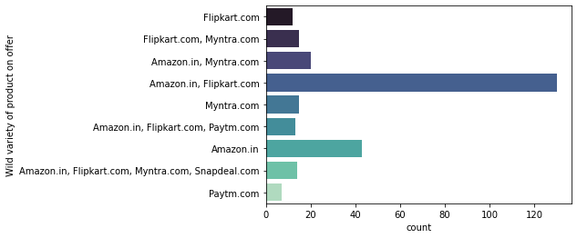
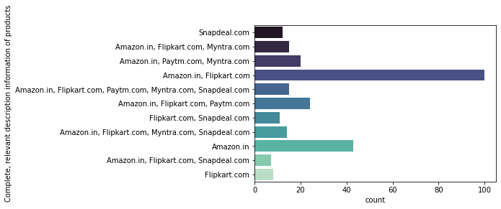

Slide 15
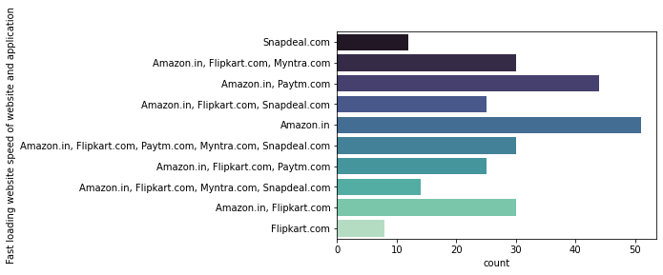
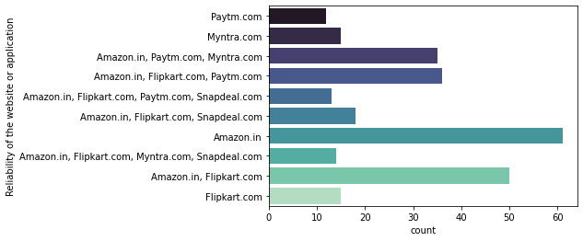
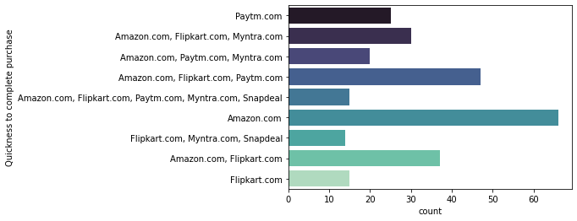
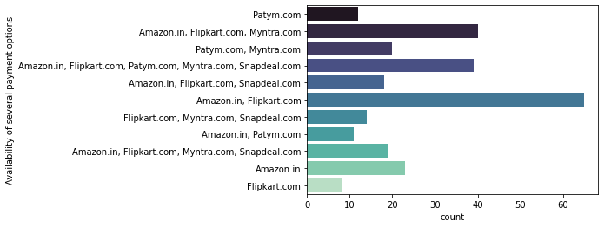

Slide 16
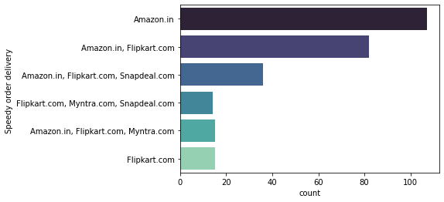
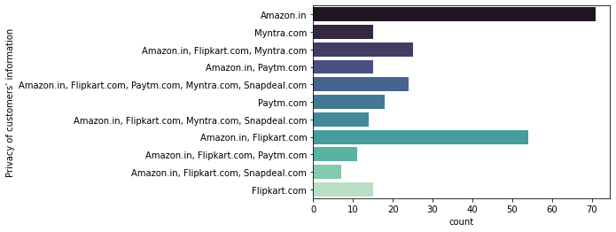
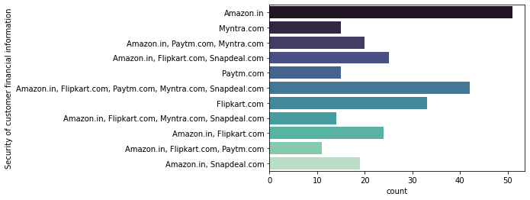
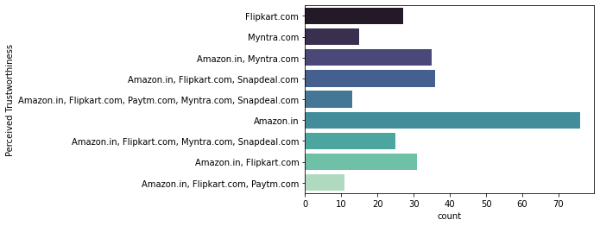

Slide 17
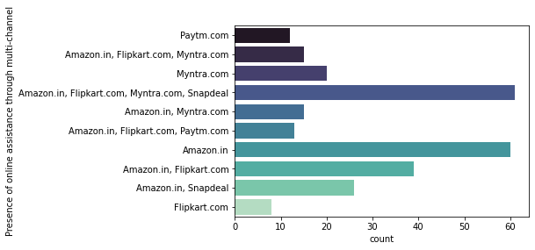
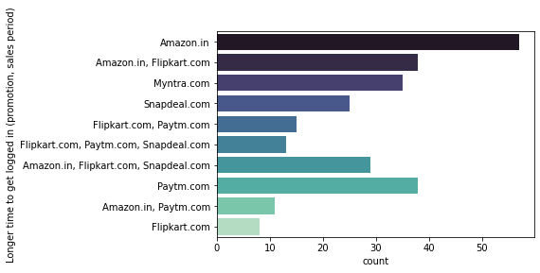
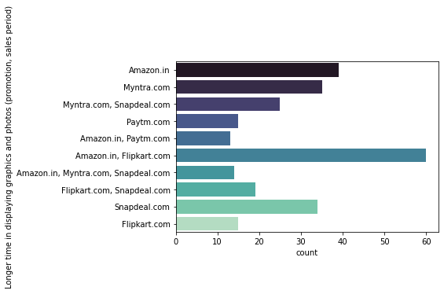
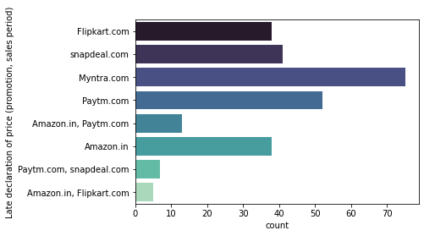

Slide 18
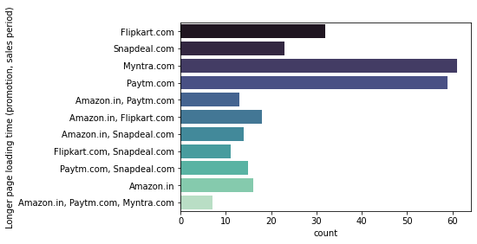
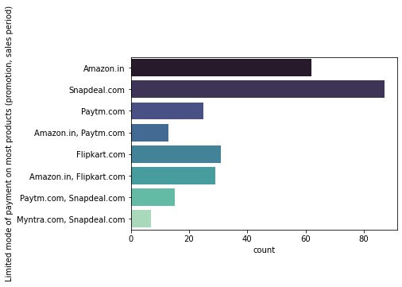
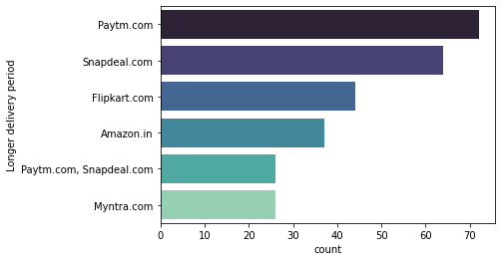
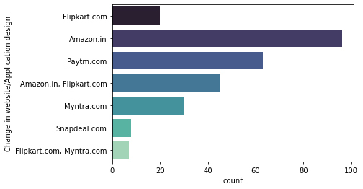

Slide 19
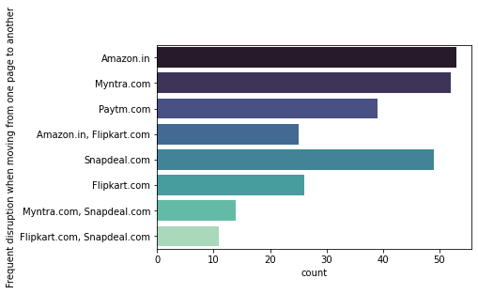
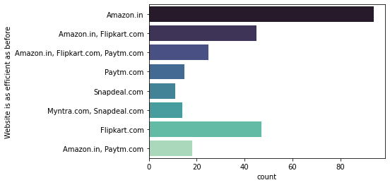
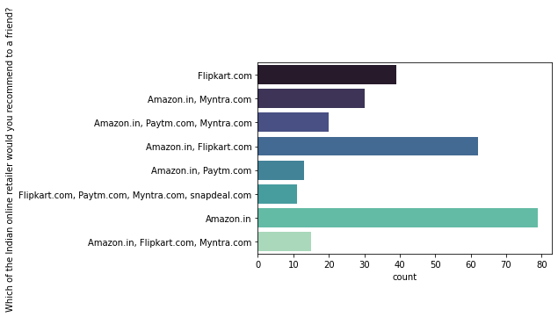

Slide 20
As we can see in above countplot graphs the “Amazon” is working very well in most of the areas.
But areas like website i.e. Login Time and smooth Transition from one page to another page in website or application page have to be consider as a weak point.
Other companies are also doing well but they have to improve their services in many areas .

Slide 21
Conclusion
Now we can say for better customer retention the companies should have target female customers , customers age group of 21-30 , customers who have 3-4 years of shopping history.
On the other hand they should have also improve their service related area like app improvement,website improvement,customer care services, better payment options,delivery options and delivery time,privacy of customer's personal data and financial data,variety of offers,variety of listed products,better information of products.
Better the customer's experience, better the customer retention.n.

Slide 22
THANK YOU

